Slide 1
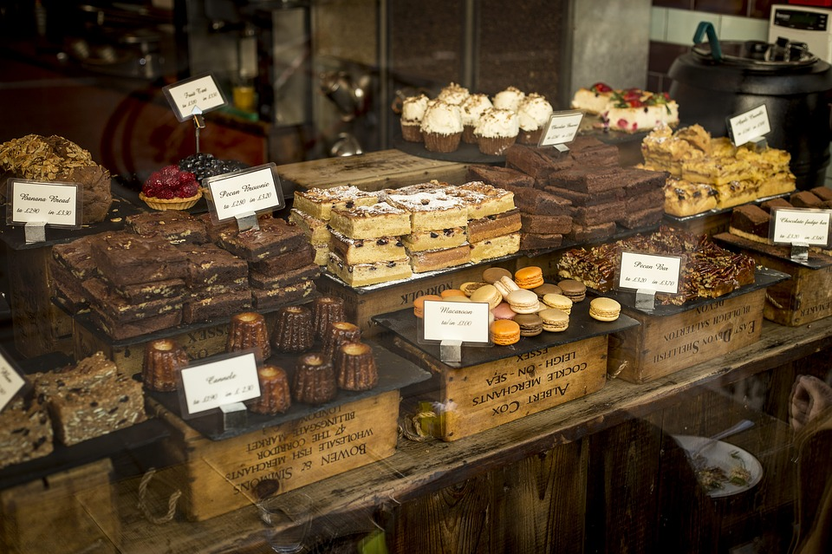
Online chocolate Shop Management
System
Presented by: Crazy Engineers

Slide 2




team
Md Nazim Uddin
Priyanka Rani Satu
Md. Naeemul Hasan
Janith Sultana
CSE 063 07429
CSE 063 07380
CSE 063 07438
CSE 063 07477

Slide 3

Introduction
Online Shop means?
Many Types of Chocolate?
Guiding and control Chocolate shop ?

Slide 4

Motivation
.
Online Purchase
Good quality of product
Fulfill the customers demand
Affordable cost for customer

Slide 5





Features
Registration
Updating
Purchasing
Data processing
Ordering

Slide 6

Feasibilities
Technical
Economical
Operational

Slide 7

Technical Feasibility
Laptop & PC
Internet Connection
Open Source Software
OS as Windows 10

Slide 8
Economical Feasibility
1
2
3
Communication Cost
Update Cost
Server cost

Slide 9



Operational Feasibility
Efficient
Customers comment
Timely delivery

Slide 10

Cost Benefit Analysis
Client Sided
Developer Sided

Slide 11

Project Scheduling
Analysis
Planning
Construction
Deployment

Slide 12
Analysis
Activity | Description | Precedence | Time (in week/s)
1 | Meeting | None | 1
2 | Agree on Objectives | 1 | 1
3 | Research on Market | 2 | 1
4 | Requirement Gathering | 1,2 | 1

Slide 13
Planning
Activity | Description | Precedence | Time (in week/s)
5 | System Design | 4 | 1
6 | Database Design | 5 | 1
7 | Database Implementation | 6 | 1

Slide 14
Construction
Activity | Description | Precedence | Time (in week/s)
8 | User Interface Designing | 5 | 2
9 | Admin Panel Designing | 5 | 1
10 | Coding | 8,9 | 4

Slide 15
Deployment
Activity | Description | Precedence | Time (in week/s)
11 | Testing | 10 | 2
12 | Feedback launch | 11 | 1
13 | launch | 12 | 1

Slide 16
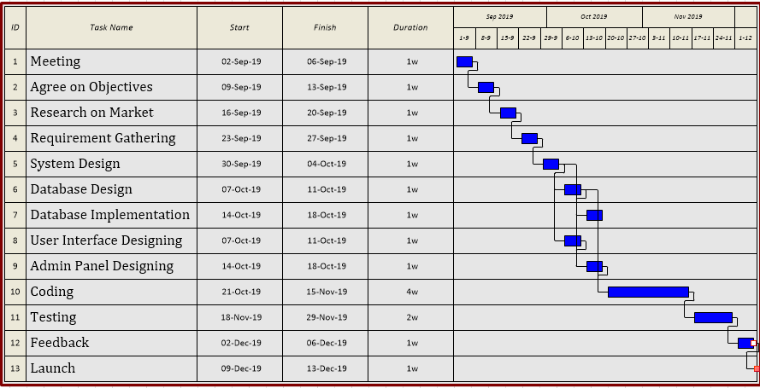
Gantt Chart

Slide 17

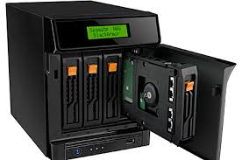
Risk Analysis
Information Secured
Database Backup
Server Secured
Server all time Up

Slide 18

Question ?

Slide 19
Thank You

